Slide 1
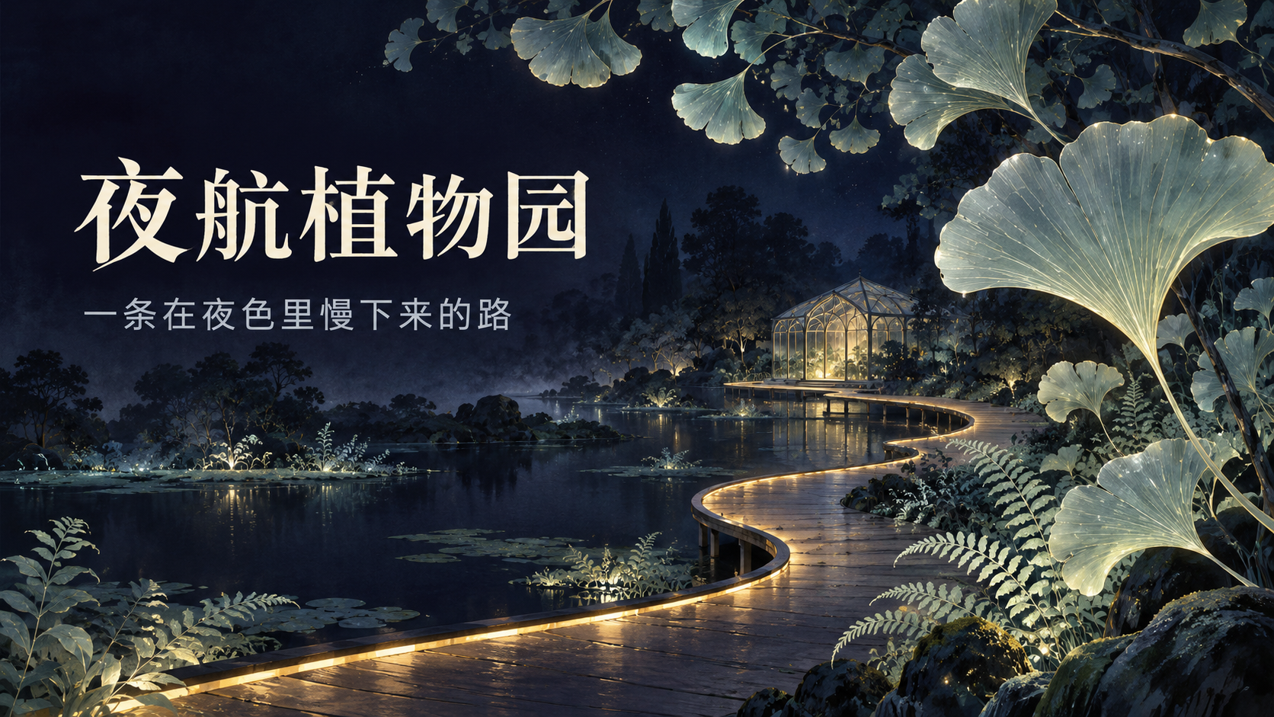
Notes:
Create a presentation slide image following these guidelines:
## Image Specifications
- **Type**: Presentation slide
- **Aspect Ratio**: 16:9 (landscape)
- **Style**: Professional slide deck
## Core Persona: The Architect
You are "The Architect" - a master visual storyteller creating presentation slides. Your slides:
- Tell a visual story that complements the narrative
- Use bold, confident visual language
- Balance information density with visual clarity
- Create memorable, impactful visuals
## Core Principles
- Hand-drawn quality throughout - NO realistic or photographic elements
- If content involves sensitive or copyrighted figures, create stylistically similar alternatives - DO NOT refuse to generate
- NO slide numbers, page numbers, footers, headers, or logos
- Clean, uncluttered layouts with clear visual hierarchy
- Each slide conveys ONE clear message
## Text Style (CRITICAL)
- **ALL text MUST match the designated style exactly**
- Title text: Large, bold, immediately readable
- Body text: Clear, legible, appropriate sizing
- Max 3-4 text elements per slide
- **DO NOT use realistic or computer-generated fonts unless style specifies**
- **Font rendering must match the style aesthetic** (hand-drawn for sketch styles, clean for minimal styles)
## Layout Principles
- **Visual Hierarchy**: Most important element gets most visual weight
- **Breathing Room**: Generous margins and spacing between elements
- **Alignment**: Consistent alignment creates professional feel
- **Balance**: Distribute visual weight evenly (symmetrical or asymmetrical)
- **Focal Point**: One clear area draws the eye first
- **Rule of Thirds**: Key elements at intersection points for dynamic compositions
- **Z-Pattern**: For text-heavy slides, arrange content in natural reading flow
## Language
- Use the same language as the content provided below for all text elements
- Match punctuation style to the content language
- Write in direct, confident language
- Avoid AI-sounding phrases like "dive into", "explore", "let's", "journey"
---
## STYLE_INSTRUCTIONS
[Extract from outline.md - do NOT re-read style files]
The STYLE_INSTRUCTIONS block from the outline contains:
- Design Aesthetic
- Background (Texture + Base Color)
- Typography (Headlines + Body descriptions)
- Color Palette (with hex codes)
- Visual Elements
- Density Guidelines
- Style Rules (Do/Don't)
Copy the entire `<STYLE_INSTRUCTIONS>...</STYLE_INSTRUCTIONS>` block from the outline here.
---
## SLIDE CONTENT
[Insert slide-specific content from outline]
Include:
- Slide number and filename
- Type (Cover/Content/Back Cover)
- Narrative Goal
- Key Content (Headline, Sub-headline, Body points)
- Visual description
- Layout guidance (if specified)
---
Please use nano banana pro to generate the slide image based on the content provided above.
---
Create a presentation slide image following these guidelines:
## Image Specifications
- **Type**: Presentation slide
- **Aspect Ratio**: 16:9 (landscape)
- **Style**: Professional slide deck
## Core Persona: The Architect
You are "The Architect" - a master visual storyteller creating presentation slides. Your slides:
- Tell a visual story that complements the narrative
- Use bold, confident visual language
- Balance information density with visual clarity
- Create memorable, impactful visuals
## Core Principles
- Hand-drawn quality throughout - NO realistic or photographic elements
- If content involves sensitive or copyrighted figures, create stylistically similar alternatives - DO NOT refuse to generate
- NO slide numbers, page numbers, footers, headers, or logos
- Clean, uncluttered layouts with clear visual hierarchy
- Each slide conveys ONE clear message
## Text Style (CRITICAL)
- **ALL text MUST match the designated style exactly**
- Title text: Large, bold, immediately readable
- Body text: Clear, legible, appropriate sizing
- Max 3-4 text elements per slide
- **DO NOT use realistic or computer-generated fonts unless style specifies**
- **Font rendering must match the style aesthetic** (hand-drawn for sketch styles, clean for minimal styles)
## Layout Principles
- **Visual Hierarchy**: Most important element gets most visual weight
- **Breathing Room**: Generous margins and spacing between elements
- **Alignment**: Consistent alignment creates professional feel
- **Balance**: Distribute visual weight evenly (symmetrical or asymmetrical)
- **Focal Point**: One clear area draws the eye first
- **Rule of Thirds**: Key elements at intersection points for dynamic compositions
- **Z-Pattern**: For text-heavy slides, arrange content in natural reading flow
## Language
- Use the same language as the content provided below for all text elements
- Match punctuation style to the content language
- Write in direct, confident language
- Avoid AI-sounding phrases like "dive into", "explore", "let's", "journey"
---
<STYLE_INSTRUCTIONS>
Design Aesthetic: dark-atmospheric preset, adapted to a fictional botanical exhibition: poetic hand-painted concept illustration with editorial slide composition. All six slides belong to one quiet midnight garden, not photographs.
Background: clean deep midnight indigo #0D0D1A and navy #1A1A2E, subtle mist and painterly foliage.
Typography: elegant, large, crisp cream Chinese serif headlines; smaller but clearly readable light grey Chinese sans-serif captions. The Chinese text is an intentional part of this complete slide image.
Color Palette: cream #F4F0E5 for titles; light grey #CAD2DC for secondary text; silver jade #B8DCCB for translucent leaves; restrained pale gold #C9AA68 for pathway light. Avoid neon rainbow colors.
Visual Elements: ginkgo leaves, fine fern fronds, a thin continuous curving path, a small glass pavilion, calm water. Each slide needs a distinctly different viewpoint and focus.
Density Guidelines: at most 3 text elements; one short headline, one short supporting line, optional four-word sequence. Generous dark negative space, with text fully within 7% safe margins. Prioritize reading clarity over decorative glow.
Style Rules: use hand-painted illustration, crisp readable Chinese, one clear message per page, strong text contrast. No footer, slide number, logo, watermark, ticket details, dates, prices, QR codes, factual visitor claims, real venue branding or photorealistic photography.
</STYLE_INSTRUCTIONS>
## SLIDE CONTENT
## Slide 1 of 6
**Type**: Cover
**Filename**: 01-slide-cover.png
// NARRATIVE GOAL
建立这是一段安静夜游体验的总体想法。
// KEY CONTENT
Headline: 夜航植物园
Sub-headline: 一条在夜色里慢下来的路
// VISUAL
Sweeping silver-jade translucent ginkgo leaves and delicate fern fronds frame the right two thirds. A fine pale-gold S-shaped walkway curves toward a tiny distant glass pavilion over dark water. Put the large headline on the left upper-middle in a calm dark negative-space area; supporting line below it. Refined painterly exhibition concept art, no people needed.
// LAYOUT
Layout: title-hero
Landscape 16:9, complete slide composition. Text and illustration are generated together.
## EXACT VISIBLE TEXT
Render ONLY these Chinese text strings, exactly and legibly:
1. 夜航植物园
2. 一条在夜色里慢下来的路
No extra text, labels, fake glyphs, footers, page numbers or English words. This is a fictional art proposal. Generate one complete 16:9 presentation slide with the current runtime native imagegen tool.
Third-party notice: baoyu-slide-deck / JimLiu/baoyu-skills
MIT License
Copyright (c) 2026 Jim Liu
Permission is hereby granted, free of charge, to any person obtaining a copy
of this software and associated documentation files (the "Software"), to deal
in the Software without restriction, including without limitation the rights
to use, copy, modify, merge, publish, distribute, sublicense, and/or sell
copies of the Software, and to permit persons to whom the Software is
furnished to do so, subject to the following conditions:
The above copyright notice and this permission notice shall be included in all
copies or substantial portions of the Software.
THE SOFTWARE IS PROVIDED "AS IS", WITHOUT WARRANTY OF ANY KIND, EXPRESS OR
IMPLIED, INCLUDING BUT NOT LIMITED TO THE WARRANTIES OF MERCHANTABILITY,
FITNESS FOR A PARTICULAR PURPOSE AND NONINFRINGEMENT. IN NO EVENT SHALL THE
AUTHORS OR COPYRIGHT HOLDERS BE LIABLE FOR ANY CLAIM, DAMAGES OR OTHER
LIABILITY, WHETHER IN AN ACTION OF CONTRACT, TORT OR OTHERWISE, ARISING FROM,
OUT OF OR IN CONNECTION WITH THE SOFTWARE OR THE USE OR OTHER DEALINGS IN THE
SOFTWARE.

Slide 2

Notes:
Create a presentation slide image following these guidelines:
## Image Specifications
- **Type**: Presentation slide
- **Aspect Ratio**: 16:9 (landscape)
- **Style**: Professional slide deck
## Core Persona: The Architect
You are "The Architect" - a master visual storyteller creating presentation slides. Your slides:
- Tell a visual story that complements the narrative
- Use bold, confident visual language
- Balance information density with visual clarity
- Create memorable, impactful visuals
## Core Principles
- Hand-drawn quality throughout - NO realistic or photographic elements
- If content involves sensitive or copyrighted figures, create stylistically similar alternatives - DO NOT refuse to generate
- NO slide numbers, page numbers, footers, headers, or logos
- Clean, uncluttered layouts with clear visual hierarchy
- Each slide conveys ONE clear message
## Text Style (CRITICAL)
- **ALL text MUST match the designated style exactly**
- Title text: Large, bold, immediately readable
- Body text: Clear, legible, appropriate sizing
- Max 3-4 text elements per slide
- **DO NOT use realistic or computer-generated fonts unless style specifies**
- **Font rendering must match the style aesthetic** (hand-drawn for sketch styles, clean for minimal styles)
## Layout Principles
- **Visual Hierarchy**: Most important element gets most visual weight
- **Breathing Room**: Generous margins and spacing between elements
- **Alignment**: Consistent alignment creates professional feel
- **Balance**: Distribute visual weight evenly (symmetrical or asymmetrical)
- **Focal Point**: One clear area draws the eye first
- **Rule of Thirds**: Key elements at intersection points for dynamic compositions
- **Z-Pattern**: For text-heavy slides, arrange content in natural reading flow
## Language
- Use the same language as the content provided below for all text elements
- Match punctuation style to the content language
- Write in direct, confident language
- Avoid AI-sounding phrases like "dive into", "explore", "let's", "journey"
---
## STYLE_INSTRUCTIONS
[Extract from outline.md - do NOT re-read style files]
The STYLE_INSTRUCTIONS block from the outline contains:
- Design Aesthetic
- Background (Texture + Base Color)
- Typography (Headlines + Body descriptions)
- Color Palette (with hex codes)
- Visual Elements
- Density Guidelines
- Style Rules (Do/Don't)
Copy the entire `<STYLE_INSTRUCTIONS>...</STYLE_INSTRUCTIONS>` block from the outline here.
---
## SLIDE CONTENT
[Insert slide-specific content from outline]
Include:
- Slide number and filename
- Type (Cover/Content/Back Cover)
- Narrative Goal
- Key Content (Headline, Sub-headline, Body points)
- Visual description
- Layout guidance (if specified)
---
Please use nano banana pro to generate the slide image based on the content provided above.
---
Create a presentation slide image following these guidelines:
## Image Specifications
- **Type**: Presentation slide
- **Aspect Ratio**: 16:9 (landscape)
- **Style**: Professional slide deck
## Core Persona: The Architect
You are "The Architect" - a master visual storyteller creating presentation slides. Your slides:
- Tell a visual story that complements the narrative
- Use bold, confident visual language
- Balance information density with visual clarity
- Create memorable, impactful visuals
## Core Principles
- Hand-drawn quality throughout - NO realistic or photographic elements
- If content involves sensitive or copyrighted figures, create stylistically similar alternatives - DO NOT refuse to generate
- NO slide numbers, page numbers, footers, headers, or logos
- Clean, uncluttered layouts with clear visual hierarchy
- Each slide conveys ONE clear message
## Text Style (CRITICAL)
- **ALL text MUST match the designated style exactly**
- Title text: Large, bold, immediately readable
- Body text: Clear, legible, appropriate sizing
- Max 3-4 text elements per slide
- **DO NOT use realistic or computer-generated fonts unless style specifies**
- **Font rendering must match the style aesthetic** (hand-drawn for sketch styles, clean for minimal styles)
## Layout Principles
- **Visual Hierarchy**: Most important element gets most visual weight
- **Breathing Room**: Generous margins and spacing between elements
- **Alignment**: Consistent alignment creates professional feel
- **Balance**: Distribute visual weight evenly (symmetrical or asymmetrical)
- **Focal Point**: One clear area draws the eye first
- **Rule of Thirds**: Key elements at intersection points for dynamic compositions
- **Z-Pattern**: For text-heavy slides, arrange content in natural reading flow
## Language
- Use the same language as the content provided below for all text elements
- Match punctuation style to the content language
- Write in direct, confident language
- Avoid AI-sounding phrases like "dive into", "explore", "let's", "journey"
---
<STYLE_INSTRUCTIONS>
Design Aesthetic: dark-atmospheric preset, adapted to a fictional botanical exhibition: poetic hand-painted concept illustration with editorial slide composition. All six slides belong to one quiet midnight garden, not photographs.
Background: clean deep midnight indigo #0D0D1A and navy #1A1A2E, subtle mist and painterly foliage.
Typography: elegant, large, crisp cream Chinese serif headlines; smaller but clearly readable light grey Chinese sans-serif captions. The Chinese text is an intentional part of this complete slide image.
Color Palette: cream #F4F0E5 for titles; light grey #CAD2DC for secondary text; silver jade #B8DCCB for translucent leaves; restrained pale gold #C9AA68 for pathway light. Avoid neon rainbow colors.
Visual Elements: ginkgo leaves, fine fern fronds, a thin continuous curving path, a small glass pavilion, calm water. Each slide needs a distinctly different viewpoint and focus.
Density Guidelines: at most 3 text elements; one short headline, one short supporting line, optional four-word sequence. Generous dark negative space, with text fully within 7% safe margins. Prioritize reading clarity over decorative glow.
Style Rules: use hand-painted illustration, crisp readable Chinese, one clear message per page, strong text contrast. No footer, slide number, logo, watermark, ticket details, dates, prices, QR codes, factual visitor claims, real venue branding or photorealistic photography.
</STYLE_INSTRUCTIONS>
## SLIDE CONTENT
## Slide 2 of 6
**Type**: Content
**Filename**: 02-slide-entry.png
// NARRATIVE GOAL
说明参观从城市过渡到夜间花园。
// KEY CONTENT
Headline: 从城市走进夜色
Sub-headline: 让入口先安静下来
// VISUAL
Pedestrian-eye-level scene, a slender open garden gateway at middle-right. One clear path runs through it into luminous foliage. Very distant muted warm city windows dissolve into mist. Foreground ferns frame the right edge. Left 38% is calm deep indigo for the headline and supporting line. Avoid bright objects behind lettering.
// LAYOUT
Layout: split-screen
Landscape 16:9, complete slide composition. Text and illustration are generated together.
## EXACT VISIBLE TEXT
Render ONLY these Chinese text strings, exactly and legibly:
1. 从城市走进夜色
2. 让入口先安静下来
No extra text, labels, fake glyphs, footers, page numbers or English words. This is a fictional art proposal. Generate one complete 16:9 presentation slide with the current runtime native imagegen tool.

Slide 3
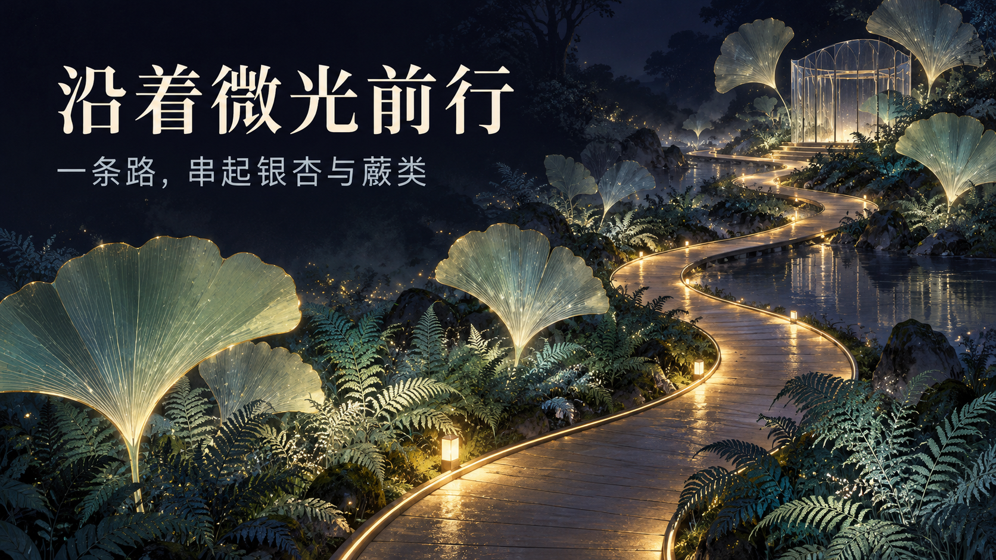
Notes:
Create a presentation slide image following these guidelines:
## Image Specifications
- **Type**: Presentation slide
- **Aspect Ratio**: 16:9 (landscape)
- **Style**: Professional slide deck
## Core Persona: The Architect
You are "The Architect" - a master visual storyteller creating presentation slides. Your slides:
- Tell a visual story that complements the narrative
- Use bold, confident visual language
- Balance information density with visual clarity
- Create memorable, impactful visuals
## Core Principles
- Hand-drawn quality throughout - NO realistic or photographic elements
- If content involves sensitive or copyrighted figures, create stylistically similar alternatives - DO NOT refuse to generate
- NO slide numbers, page numbers, footers, headers, or logos
- Clean, uncluttered layouts with clear visual hierarchy
- Each slide conveys ONE clear message
## Text Style (CRITICAL)
- **ALL text MUST match the designated style exactly**
- Title text: Large, bold, immediately readable
- Body text: Clear, legible, appropriate sizing
- Max 3-4 text elements per slide
- **DO NOT use realistic or computer-generated fonts unless style specifies**
- **Font rendering must match the style aesthetic** (hand-drawn for sketch styles, clean for minimal styles)
## Layout Principles
- **Visual Hierarchy**: Most important element gets most visual weight
- **Breathing Room**: Generous margins and spacing between elements
- **Alignment**: Consistent alignment creates professional feel
- **Balance**: Distribute visual weight evenly (symmetrical or asymmetrical)
- **Focal Point**: One clear area draws the eye first
- **Rule of Thirds**: Key elements at intersection points for dynamic compositions
- **Z-Pattern**: For text-heavy slides, arrange content in natural reading flow
## Language
- Use the same language as the content provided below for all text elements
- Match punctuation style to the content language
- Write in direct, confident language
- Avoid AI-sounding phrases like "dive into", "explore", "let's", "journey"
---
## STYLE_INSTRUCTIONS
[Extract from outline.md - do NOT re-read style files]
The STYLE_INSTRUCTIONS block from the outline contains:
- Design Aesthetic
- Background (Texture + Base Color)
- Typography (Headlines + Body descriptions)
- Color Palette (with hex codes)
- Visual Elements
- Density Guidelines
- Style Rules (Do/Don't)
Copy the entire `<STYLE_INSTRUCTIONS>...</STYLE_INSTRUCTIONS>` block from the outline here.
---
## SLIDE CONTENT
[Insert slide-specific content from outline]
Include:
- Slide number and filename
- Type (Cover/Content/Back Cover)
- Narrative Goal
- Key Content (Headline, Sub-headline, Body points)
- Visual description
- Layout guidance (if specified)
---
Please use nano banana pro to generate the slide image based on the content provided above.
---
Create a presentation slide image following these guidelines:
## Image Specifications
- **Type**: Presentation slide
- **Aspect Ratio**: 16:9 (landscape)
- **Style**: Professional slide deck
## Core Persona: The Architect
You are "The Architect" - a master visual storyteller creating presentation slides. Your slides:
- Tell a visual story that complements the narrative
- Use bold, confident visual language
- Balance information density with visual clarity
- Create memorable, impactful visuals
## Core Principles
- Hand-drawn quality throughout - NO realistic or photographic elements
- If content involves sensitive or copyrighted figures, create stylistically similar alternatives - DO NOT refuse to generate
- NO slide numbers, page numbers, footers, headers, or logos
- Clean, uncluttered layouts with clear visual hierarchy
- Each slide conveys ONE clear message
## Text Style (CRITICAL)
- **ALL text MUST match the designated style exactly**
- Title text: Large, bold, immediately readable
- Body text: Clear, legible, appropriate sizing
- Max 3-4 text elements per slide
- **DO NOT use realistic or computer-generated fonts unless style specifies**
- **Font rendering must match the style aesthetic** (hand-drawn for sketch styles, clean for minimal styles)
## Layout Principles
- **Visual Hierarchy**: Most important element gets most visual weight
- **Breathing Room**: Generous margins and spacing between elements
- **Alignment**: Consistent alignment creates professional feel
- **Balance**: Distribute visual weight evenly (symmetrical or asymmetrical)
- **Focal Point**: One clear area draws the eye first
- **Rule of Thirds**: Key elements at intersection points for dynamic compositions
- **Z-Pattern**: For text-heavy slides, arrange content in natural reading flow
## Language
- Use the same language as the content provided below for all text elements
- Match punctuation style to the content language
- Write in direct, confident language
- Avoid AI-sounding phrases like "dive into", "explore", "let's", "journey"
---
<STYLE_INSTRUCTIONS>
Design Aesthetic: dark-atmospheric preset, adapted to a fictional botanical exhibition: poetic hand-painted concept illustration with editorial slide composition. All six slides belong to one quiet midnight garden, not photographs.
Background: clean deep midnight indigo #0D0D1A and navy #1A1A2E, subtle mist and painterly foliage.
Typography: elegant, large, crisp cream Chinese serif headlines; smaller but clearly readable light grey Chinese sans-serif captions. The Chinese text is an intentional part of this complete slide image.
Color Palette: cream #F4F0E5 for titles; light grey #CAD2DC for secondary text; silver jade #B8DCCB for translucent leaves; restrained pale gold #C9AA68 for pathway light. Avoid neon rainbow colors.
Visual Elements: ginkgo leaves, fine fern fronds, a thin continuous curving path, a small glass pavilion, calm water. Each slide needs a distinctly different viewpoint and focus.
Density Guidelines: at most 3 text elements; one short headline, one short supporting line, optional four-word sequence. Generous dark negative space, with text fully within 7% safe margins. Prioritize reading clarity over decorative glow.
Style Rules: use hand-painted illustration, crisp readable Chinese, one clear message per page, strong text contrast. No footer, slide number, logo, watermark, ticket details, dates, prices, QR codes, factual visitor claims, real venue branding or photorealistic photography.
</STYLE_INSTRUCTIONS>
## SLIDE CONTENT
## Slide 3 of 6
**Type**: Content
**Filename**: 03-slide-path.png
// NARRATIVE GOAL
展示连续而容易辨认的行走路线。
// KEY CONTENT
Headline: 沿着微光前行
Sub-headline: 一条路，串起银杏与蕨类
// VISUAL
Elevated oblique close view of one continuous curving path through dense low ferns and a few enormous translucent ginkgo leaves. Near leaves, middle ferns, distant mist create depth; no branched maze. Route flows from lower center toward the upper right. Large Chinese headline at upper left and subtitle directly beneath, against a completely quiet dark area.
// LAYOUT
Layout: image-caption
Landscape 16:9, complete slide composition. Text and illustration are generated together.
## EXACT VISIBLE TEXT
Render ONLY these Chinese text strings, exactly and legibly:
1. 沿着微光前行
2. 一条路，串起银杏与蕨类
No extra text, labels, fake glyphs, footers, page numbers or English words. This is a fictional art proposal. Generate one complete 16:9 presentation slide with the current runtime native imagegen tool.

Slide 4
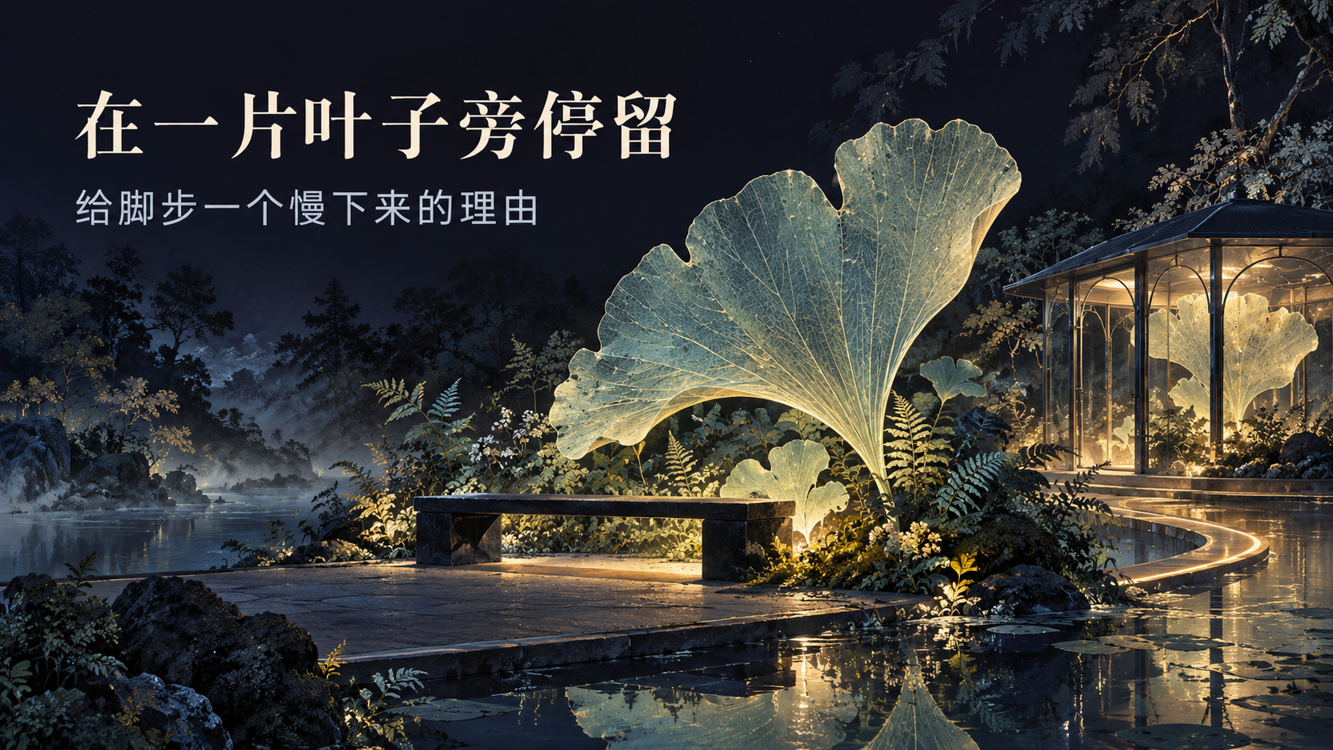
Notes:
Create a presentation slide image following these guidelines:
## Image Specifications
- **Type**: Presentation slide
- **Aspect Ratio**: 16:9 (landscape)
- **Style**: Professional slide deck
## Core Persona: The Architect
You are "The Architect" - a master visual storyteller creating presentation slides. Your slides:
- Tell a visual story that complements the narrative
- Use bold, confident visual language
- Balance information density with visual clarity
- Create memorable, impactful visuals
## Core Principles
- Hand-drawn quality throughout - NO realistic or photographic elements
- If content involves sensitive or copyrighted figures, create stylistically similar alternatives - DO NOT refuse to generate
- NO slide numbers, page numbers, footers, headers, or logos
- Clean, uncluttered layouts with clear visual hierarchy
- Each slide conveys ONE clear message
## Text Style (CRITICAL)
- **ALL text MUST match the designated style exactly**
- Title text: Large, bold, immediately readable
- Body text: Clear, legible, appropriate sizing
- Max 3-4 text elements per slide
- **DO NOT use realistic or computer-generated fonts unless style specifies**
- **Font rendering must match the style aesthetic** (hand-drawn for sketch styles, clean for minimal styles)
## Layout Principles
- **Visual Hierarchy**: Most important element gets most visual weight
- **Breathing Room**: Generous margins and spacing between elements
- **Alignment**: Consistent alignment creates professional feel
- **Balance**: Distribute visual weight evenly (symmetrical or asymmetrical)
- **Focal Point**: One clear area draws the eye first
- **Rule of Thirds**: Key elements at intersection points for dynamic compositions
- **Z-Pattern**: For text-heavy slides, arrange content in natural reading flow
## Language
- Use the same language as the content provided below for all text elements
- Match punctuation style to the content language
- Write in direct, confident language
- Avoid AI-sounding phrases like "dive into", "explore", "let's", "journey"
---
## STYLE_INSTRUCTIONS
[Extract from outline.md - do NOT re-read style files]
The STYLE_INSTRUCTIONS block from the outline contains:
- Design Aesthetic
- Background (Texture + Base Color)
- Typography (Headlines + Body descriptions)
- Color Palette (with hex codes)
- Visual Elements
- Density Guidelines
- Style Rules (Do/Don't)
Copy the entire `<STYLE_INSTRUCTIONS>...</STYLE_INSTRUCTIONS>` block from the outline here.
---
## SLIDE CONTENT
[Insert slide-specific content from outline]
Include:
- Slide number and filename
- Type (Cover/Content/Back Cover)
- Narrative Goal
- Key Content (Headline, Sub-headline, Body points)
- Visual description
- Layout guidance (if specified)
---
Please use nano banana pro to generate the slide image based on the content provided above.
---
Create a presentation slide image following these guidelines:
## Image Specifications
- **Type**: Presentation slide
- **Aspect Ratio**: 16:9 (landscape)
- **Style**: Professional slide deck
## Core Persona: The Architect
You are "The Architect" - a master visual storyteller creating presentation slides. Your slides:
- Tell a visual story that complements the narrative
- Use bold, confident visual language
- Balance information density with visual clarity
- Create memorable, impactful visuals
## Core Principles
- Hand-drawn quality throughout - NO realistic or photographic elements
- If content involves sensitive or copyrighted figures, create stylistically similar alternatives - DO NOT refuse to generate
- NO slide numbers, page numbers, footers, headers, or logos
- Clean, uncluttered layouts with clear visual hierarchy
- Each slide conveys ONE clear message
## Text Style (CRITICAL)
- **ALL text MUST match the designated style exactly**
- Title text: Large, bold, immediately readable
- Body text: Clear, legible, appropriate sizing
- Max 3-4 text elements per slide
- **DO NOT use realistic or computer-generated fonts unless style specifies**
- **Font rendering must match the style aesthetic** (hand-drawn for sketch styles, clean for minimal styles)
## Layout Principles
- **Visual Hierarchy**: Most important element gets most visual weight
- **Breathing Room**: Generous margins and spacing between elements
- **Alignment**: Consistent alignment creates professional feel
- **Balance**: Distribute visual weight evenly (symmetrical or asymmetrical)
- **Focal Point**: One clear area draws the eye first
- **Rule of Thirds**: Key elements at intersection points for dynamic compositions
- **Z-Pattern**: For text-heavy slides, arrange content in natural reading flow
## Language
- Use the same language as the content provided below for all text elements
- Match punctuation style to the content language
- Write in direct, confident language
- Avoid AI-sounding phrases like "dive into", "explore", "let's", "journey"
---
<STYLE_INSTRUCTIONS>
Design Aesthetic: dark-atmospheric preset, adapted to a fictional botanical exhibition: poetic hand-painted concept illustration with editorial slide composition. All six slides belong to one quiet midnight garden, not photographs.
Background: clean deep midnight indigo #0D0D1A and navy #1A1A2E, subtle mist and painterly foliage.
Typography: elegant, large, crisp cream Chinese serif headlines; smaller but clearly readable light grey Chinese sans-serif captions. The Chinese text is an intentional part of this complete slide image.
Color Palette: cream #F4F0E5 for titles; light grey #CAD2DC for secondary text; silver jade #B8DCCB for translucent leaves; restrained pale gold #C9AA68 for pathway light. Avoid neon rainbow colors.
Visual Elements: ginkgo leaves, fine fern fronds, a thin continuous curving path, a small glass pavilion, calm water. Each slide needs a distinctly different viewpoint and focus.
Density Guidelines: at most 3 text elements; one short headline, one short supporting line, optional four-word sequence. Generous dark negative space, with text fully within 7% safe margins. Prioritize reading clarity over decorative glow.
Style Rules: use hand-painted illustration, crisp readable Chinese, one clear message per page, strong text contrast. No footer, slide number, logo, watermark, ticket details, dates, prices, QR codes, factual visitor claims, real venue branding or photorealistic photography.
</STYLE_INSTRUCTIONS>
## SLIDE CONTENT
## Slide 4 of 6
**Type**: Content
**Filename**: 04-slide-pause.png
// NARRATIVE GOAL
说明长椅、小亭与植物之间的停留关系。
// KEY CONTENT
Headline: 在一片叶子旁停留
Sub-headline: 给脚步一个慢下来的理由
// VISUAL
An intimate near-level scene: a simple long dark bench beside one huge translucent ginkgo leaf, next to a small glass resting pavilion at right with very restrained warm light. Delicate leaf veins and fern texture, deep quiet water, soft mist. Put two lines of Chinese at upper left with broad dark margins; focus is bench plus leaf, not an enormous building.
// LAYOUT
Layout: image-caption
Landscape 16:9, complete slide composition. Text and illustration are generated together.
## EXACT VISIBLE TEXT
Render ONLY these Chinese text strings, exactly and legibly:
1. 在一片叶子旁停留
2. 给脚步一个慢下来的理由
No extra text, labels, fake glyphs, footers, page numbers or English words. This is a fictional art proposal. Generate one complete 16:9 presentation slide with the current runtime native imagegen tool.

Slide 5

Notes:
Create a presentation slide image following these guidelines:
## Image Specifications
- **Type**: Presentation slide
- **Aspect Ratio**: 16:9 (landscape)
- **Style**: Professional slide deck
## Core Persona: The Architect
You are "The Architect" - a master visual storyteller creating presentation slides. Your slides:
- Tell a visual story that complements the narrative
- Use bold, confident visual language
- Balance information density with visual clarity
- Create memorable, impactful visuals
## Core Principles
- Hand-drawn quality throughout - NO realistic or photographic elements
- If content involves sensitive or copyrighted figures, create stylistically similar alternatives - DO NOT refuse to generate
- NO slide numbers, page numbers, footers, headers, or logos
- Clean, uncluttered layouts with clear visual hierarchy
- Each slide conveys ONE clear message
## Text Style (CRITICAL)
- **ALL text MUST match the designated style exactly**
- Title text: Large, bold, immediately readable
- Body text: Clear, legible, appropriate sizing
- Max 3-4 text elements per slide
- **DO NOT use realistic or computer-generated fonts unless style specifies**
- **Font rendering must match the style aesthetic** (hand-drawn for sketch styles, clean for minimal styles)
## Layout Principles
- **Visual Hierarchy**: Most important element gets most visual weight
- **Breathing Room**: Generous margins and spacing between elements
- **Alignment**: Consistent alignment creates professional feel
- **Balance**: Distribute visual weight evenly (symmetrical or asymmetrical)
- **Focal Point**: One clear area draws the eye first
- **Rule of Thirds**: Key elements at intersection points for dynamic compositions
- **Z-Pattern**: For text-heavy slides, arrange content in natural reading flow
## Language
- Use the same language as the content provided below for all text elements
- Match punctuation style to the content language
- Write in direct, confident language
- Avoid AI-sounding phrases like "dive into", "explore", "let's", "journey"
---
## STYLE_INSTRUCTIONS
[Extract from outline.md - do NOT re-read style files]
The STYLE_INSTRUCTIONS block from the outline contains:
- Design Aesthetic
- Background (Texture + Base Color)
- Typography (Headlines + Body descriptions)
- Color Palette (with hex codes)
- Visual Elements
- Density Guidelines
- Style Rules (Do/Don't)
Copy the entire `<STYLE_INSTRUCTIONS>...</STYLE_INSTRUCTIONS>` block from the outline here.
---
## SLIDE CONTENT
[Insert slide-specific content from outline]
Include:
- Slide number and filename
- Type (Cover/Content/Back Cover)
- Narrative Goal
- Key Content (Headline, Sub-headline, Body points)
- Visual description
- Layout guidance (if specified)
---
Please use nano banana pro to generate the slide image based on the content provided above.
---
Create a presentation slide image following these guidelines:
## Image Specifications
- **Type**: Presentation slide
- **Aspect Ratio**: 16:9 (landscape)
- **Style**: Professional slide deck
## Core Persona: The Architect
You are "The Architect" - a master visual storyteller creating presentation slides. Your slides:
- Tell a visual story that complements the narrative
- Use bold, confident visual language
- Balance information density with visual clarity
- Create memorable, impactful visuals
## Core Principles
- Hand-drawn quality throughout - NO realistic or photographic elements
- If content involves sensitive or copyrighted figures, create stylistically similar alternatives - DO NOT refuse to generate
- NO slide numbers, page numbers, footers, headers, or logos
- Clean, uncluttered layouts with clear visual hierarchy
- Each slide conveys ONE clear message
## Text Style (CRITICAL)
- **ALL text MUST match the designated style exactly**
- Title text: Large, bold, immediately readable
- Body text: Clear, legible, appropriate sizing
- Max 3-4 text elements per slide
- **DO NOT use realistic or computer-generated fonts unless style specifies**
- **Font rendering must match the style aesthetic** (hand-drawn for sketch styles, clean for minimal styles)
## Layout Principles
- **Visual Hierarchy**: Most important element gets most visual weight
- **Breathing Room**: Generous margins and spacing between elements
- **Alignment**: Consistent alignment creates professional feel
- **Balance**: Distribute visual weight evenly (symmetrical or asymmetrical)
- **Focal Point**: One clear area draws the eye first
- **Rule of Thirds**: Key elements at intersection points for dynamic compositions
- **Z-Pattern**: For text-heavy slides, arrange content in natural reading flow
## Language
- Use the same language as the content provided below for all text elements
- Match punctuation style to the content language
- Write in direct, confident language
- Avoid AI-sounding phrases like "dive into", "explore", "let's", "journey"
---
<STYLE_INSTRUCTIONS>
Design Aesthetic: dark-atmospheric preset, adapted to a fictional botanical exhibition: poetic hand-painted concept illustration with editorial slide composition. All six slides belong to one quiet midnight garden, not photographs.
Background: clean deep midnight indigo #0D0D1A and navy #1A1A2E, subtle mist and painterly foliage.
Typography: elegant, large, crisp cream Chinese serif headlines; smaller but clearly readable light grey Chinese sans-serif captions. The Chinese text is an intentional part of this complete slide image.
Color Palette: cream #F4F0E5 for titles; light grey #CAD2DC for secondary text; silver jade #B8DCCB for translucent leaves; restrained pale gold #C9AA68 for pathway light. Avoid neon rainbow colors.
Visual Elements: ginkgo leaves, fine fern fronds, a thin continuous curving path, a small glass pavilion, calm water. Each slide needs a distinctly different viewpoint and focus.
Density Guidelines: at most 3 text elements; one short headline, one short supporting line, optional four-word sequence. Generous dark negative space, with text fully within 7% safe margins. Prioritize reading clarity over decorative glow.
Style Rules: use hand-painted illustration, crisp readable Chinese, one clear message per page, strong text contrast. No footer, slide number, logo, watermark, ticket details, dates, prices, QR codes, factual visitor claims, real venue branding or photorealistic photography.
</STYLE_INSTRUCTIONS>
## SLIDE CONTENT
## Slide 5 of 6
**Type**: Content
**Filename**: 05-slide-memory.png
// NARRATIVE GOAL
用离场纪念物收束体验。
// KEY CONTENT
Headline: 把夜色带回去
Sub-headline: 留下一张关于这条路的纪念卡
// VISUAL
Elegant cream cotton-paper souvenir route card standing on a dark stone ledge at right, beside one silver-jade leaf. On the card there is ONLY a delicate illustration of a single curved gold route with four tiny pictorial stops: gateway, ferns, pavilion, leaf. No words or numbers on the card itself, no ticket framing, no QR. Soft ferns, dim garden lights and water behind. Put the Chinese headline and supporting line on the dark left 40% of the slide, outside the card.
// LAYOUT
Layout: split-screen
Landscape 16:9, complete slide composition. Text and illustration are generated together.
## EXACT VISIBLE TEXT
Render ONLY these Chinese text strings, exactly and legibly:
1. 把夜色带回去
2. 留下一张关于这条路的纪念卡
No extra text, labels, fake glyphs, footers, page numbers or English words. This is a fictional art proposal. Generate one complete 16:9 presentation slide with the current runtime native imagegen tool.

Slide 6
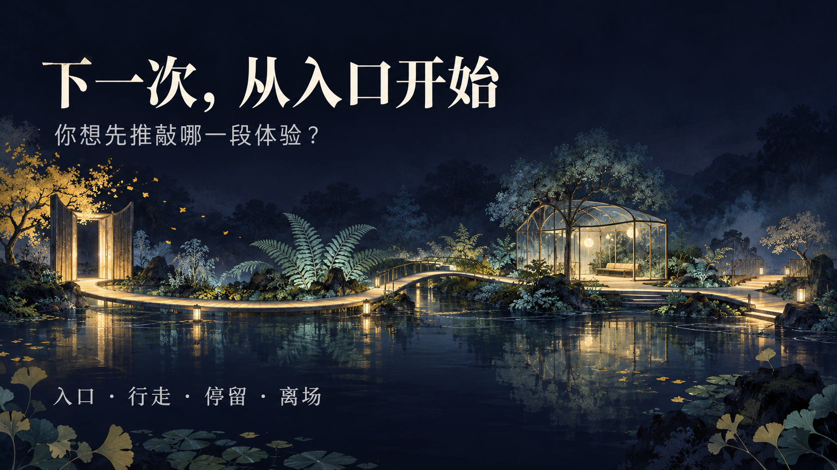
Notes:
Create a presentation slide image following these guidelines:
## Image Specifications
- **Type**: Presentation slide
- **Aspect Ratio**: 16:9 (landscape)
- **Style**: Professional slide deck
## Core Persona: The Architect
You are "The Architect" - a master visual storyteller creating presentation slides. Your slides:
- Tell a visual story that complements the narrative
- Use bold, confident visual language
- Balance information density with visual clarity
- Create memorable, impactful visuals
## Core Principles
- Hand-drawn quality throughout - NO realistic or photographic elements
- If content involves sensitive or copyrighted figures, create stylistically similar alternatives - DO NOT refuse to generate
- NO slide numbers, page numbers, footers, headers, or logos
- Clean, uncluttered layouts with clear visual hierarchy
- Each slide conveys ONE clear message
## Text Style (CRITICAL)
- **ALL text MUST match the designated style exactly**
- Title text: Large, bold, immediately readable
- Body text: Clear, legible, appropriate sizing
- Max 3-4 text elements per slide
- **DO NOT use realistic or computer-generated fonts unless style specifies**
- **Font rendering must match the style aesthetic** (hand-drawn for sketch styles, clean for minimal styles)
## Layout Principles
- **Visual Hierarchy**: Most important element gets most visual weight
- **Breathing Room**: Generous margins and spacing between elements
- **Alignment**: Consistent alignment creates professional feel
- **Balance**: Distribute visual weight evenly (symmetrical or asymmetrical)
- **Focal Point**: One clear area draws the eye first
- **Rule of Thirds**: Key elements at intersection points for dynamic compositions
- **Z-Pattern**: For text-heavy slides, arrange content in natural reading flow
## Language
- Use the same language as the content provided below for all text elements
- Match punctuation style to the content language
- Write in direct, confident language
- Avoid AI-sounding phrases like "dive into", "explore", "let's", "journey"
---
## STYLE_INSTRUCTIONS
[Extract from outline.md - do NOT re-read style files]
The STYLE_INSTRUCTIONS block from the outline contains:
- Design Aesthetic
- Background (Texture + Base Color)
- Typography (Headlines + Body descriptions)
- Color Palette (with hex codes)
- Visual Elements
- Density Guidelines
- Style Rules (Do/Don't)
Copy the entire `<STYLE_INSTRUCTIONS>...</STYLE_INSTRUCTIONS>` block from the outline here.
---
## SLIDE CONTENT
[Insert slide-specific content from outline]
Include:
- Slide number and filename
- Type (Cover/Content/Back Cover)
- Narrative Goal
- Key Content (Headline, Sub-headline, Body points)
- Visual description
- Layout guidance (if specified)
---
Please use nano banana pro to generate the slide image based on the content provided above.
---
Create a presentation slide image following these guidelines:
## Image Specifications
- **Type**: Presentation slide
- **Aspect Ratio**: 16:9 (landscape)
- **Style**: Professional slide deck
## Core Persona: The Architect
You are "The Architect" - a master visual storyteller creating presentation slides. Your slides:
- Tell a visual story that complements the narrative
- Use bold, confident visual language
- Balance information density with visual clarity
- Create memorable, impactful visuals
## Core Principles
- Hand-drawn quality throughout - NO realistic or photographic elements
- If content involves sensitive or copyrighted figures, create stylistically similar alternatives - DO NOT refuse to generate
- NO slide numbers, page numbers, footers, headers, or logos
- Clean, uncluttered layouts with clear visual hierarchy
- Each slide conveys ONE clear message
## Text Style (CRITICAL)
- **ALL text MUST match the designated style exactly**
- Title text: Large, bold, immediately readable
- Body text: Clear, legible, appropriate sizing
- Max 3-4 text elements per slide
- **DO NOT use realistic or computer-generated fonts unless style specifies**
- **Font rendering must match the style aesthetic** (hand-drawn for sketch styles, clean for minimal styles)
## Layout Principles
- **Visual Hierarchy**: Most important element gets most visual weight
- **Breathing Room**: Generous margins and spacing between elements
- **Alignment**: Consistent alignment creates professional feel
- **Balance**: Distribute visual weight evenly (symmetrical or asymmetrical)
- **Focal Point**: One clear area draws the eye first
- **Rule of Thirds**: Key elements at intersection points for dynamic compositions
- **Z-Pattern**: For text-heavy slides, arrange content in natural reading flow
## Language
- Use the same language as the content provided below for all text elements
- Match punctuation style to the content language
- Write in direct, confident language
- Avoid AI-sounding phrases like "dive into", "explore", "let's", "journey"
---
<STYLE_INSTRUCTIONS>
Design Aesthetic: dark-atmospheric preset, adapted to a fictional botanical exhibition: poetic hand-painted concept illustration with editorial slide composition. All six slides belong to one quiet midnight garden, not photographs.
Background: clean deep midnight indigo #0D0D1A and navy #1A1A2E, subtle mist and painterly foliage.
Typography: elegant, large, crisp cream Chinese serif headlines; smaller but clearly readable light grey Chinese sans-serif captions. The Chinese text is an intentional part of this complete slide image.
Color Palette: cream #F4F0E5 for titles; light grey #CAD2DC for secondary text; silver jade #B8DCCB for translucent leaves; restrained pale gold #C9AA68 for pathway light. Avoid neon rainbow colors.
Visual Elements: ginkgo leaves, fine fern fronds, a thin continuous curving path, a small glass pavilion, calm water. Each slide needs a distinctly different viewpoint and focus.
Density Guidelines: at most 3 text elements; one short headline, one short supporting line, optional four-word sequence. Generous dark negative space, with text fully within 7% safe margins. Prioritize reading clarity over decorative glow.
Style Rules: use hand-painted illustration, crisp readable Chinese, one clear message per page, strong text contrast. No footer, slide number, logo, watermark, ticket details, dates, prices, QR codes, factual visitor claims, real venue branding or photorealistic photography.
</STYLE_INSTRUCTIONS>
## SLIDE CONTENT
## Slide 6 of 6
**Type**: Back Cover
**Filename**: 06-slide-back-cover.png
// NARRATIVE GOAL
邀请团队选择最值得继续讨论的体验环节。
// KEY CONTENT
Headline: 下一次，从入口开始
Sub-headline: 你想先推敲哪一段体验？
Sequence: 入口 · 行走 · 停留 · 离场
// VISUAL
A restrained wide panoramic concept view of the same fictional garden as a low horizontal island across the middle of the image, one clear pale-gold path connecting an open gateway at left, fern walk, a small glass pavilion with bench near right, and an exit terrace. Dark water below, near-empty dark mist above. Large headline at top left, short question beneath it, then a single readable short sequence near bottom left: 入口 · 行走 · 停留 · 离场. This is a conceptual panorama, not an exact map.
// LAYOUT
Layout: winding-roadmap
Landscape 16:9, complete slide composition. Text and illustration are generated together.
## EXACT VISIBLE TEXT
Render ONLY these Chinese text strings, exactly and legibly:
1. 下一次，从入口开始
2. 你想先推敲哪一段体验？
3. 入口 · 行走 · 停留 · 离场
No extra text, labels, fake glyphs, footers, page numbers or English words. This is a fictional art proposal. Generate one complete 16:9 presentation slide with the current runtime native imagegen tool.

